Slide 1
Global Flavours
Data-Driven Menu Design For Karin’s Food Truck

Slide 2
Presentation Roadmap
Analysis Objective - 2 minutes
Dataset Overview - 2 minutes
Countries Breakdown - 1 minute
Cooking Methods Breakdown - 2 minutes
Ingredients Breakdown - 2 minutes
Vegetarian Breakdown - 1 minute
Outcome and Pricing Insights - 2 minutes
Discussion - 5 minutes

Slide 3
Analysis Objective
Karin is planning to launch an international food truck business.
Goals
Menu featuring four main dishes, each representing a different country.
Only support two cooking methods, due to space and equipment limitations.
Selected dishes must share as many ingredients as possible.
Vegetarian friendly dishes to increase customer reach.
Finally, an estimation of the final dishes sale price.

Slide 4
All About The Data
Example Table:
Dish Name | Country | Ingredients | Cooking Method | Typical Price (USD) | Vegetarian
Takoyaki | Japan | Octopus, Flour, Onion | Fried | 3.28 | No
Vada Pav | India | Potato, Bread Bun, Chutney | Fried | 2.37 | Yes
Funnel Cake | USA | Batter, Sugar, Oil | Fried | 2.78 | Yes
4500 entries including the following data:
Dish Name (25 Unique Entries)
Country (11 Unique Entries)
Ingredients (26 Unique Entries)
Cooking Method (9 Unique Entries)
Typical Price (USD)
Whether The Dish Is Vegetarian

Slide 5
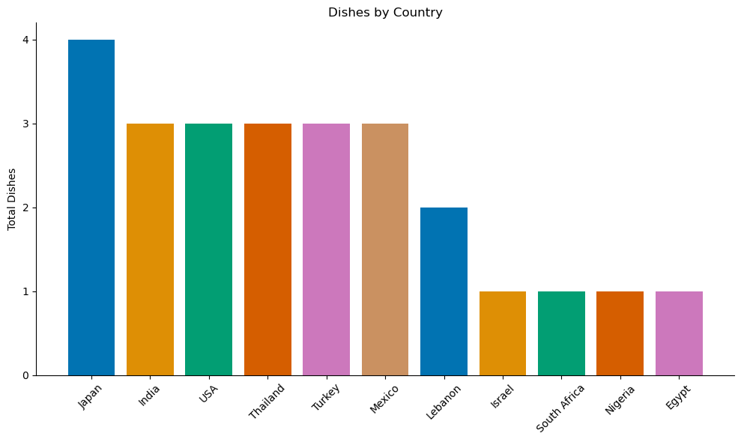
Culinary Countries
11 different countries
Top six contribute largely to the dishes in the dataset.
Popular cuisines like Japan and India are well-represented and may be more familiar to local audiences.

Slide 6
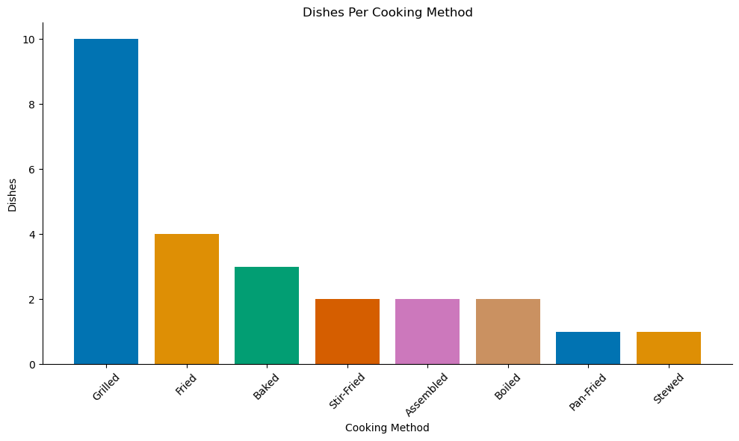
Cooking Methods
8 unique cooking techniques
Grilled is the most common by a lot
Pan-Fried and Stewed only appeared once; these may be less practical for a streamlined kitchen.

Slide 7
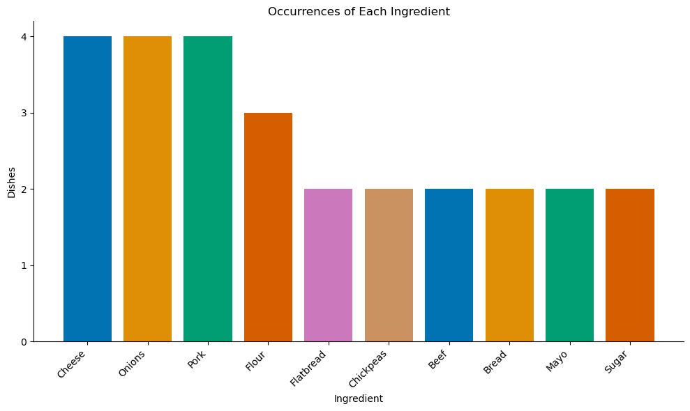
Ingredients
66 unique ingredients
Filtered out group entries (e.g Spices)
Cheese is a very popular street food ingredient

Slide 8
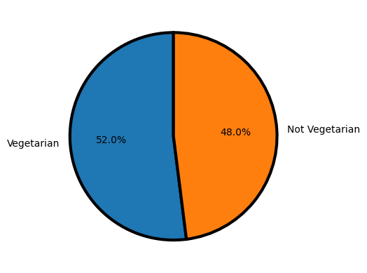
Vegetarian
Over half of the dishes are vegetarian
Vegetarian dishes often use overlapping ingredients, increasing efficiency.

Slide 9
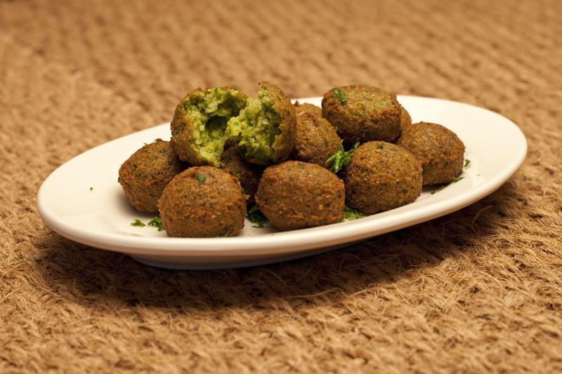
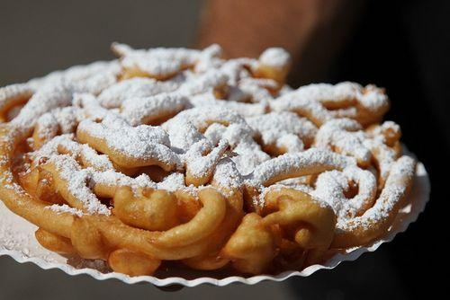
Three Dishes
Dish | Average Price (USD)
Elote | 2.60
Falafel | 2.70
Funnel Cake | 3.00

Slide 10
Discussion: Let’s Talk

